Slide 1

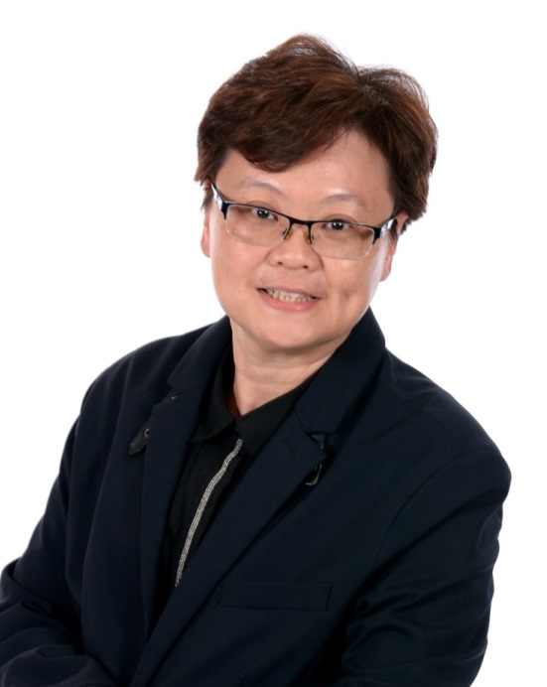

建立團隊文化
Organization Building and Power Profile
Pauline Cheng
執行高級顧問經理級
Executive Director
四個佣金週期共賺取HK$191,600
HK$191,600 in 4 Commission weeks
本簡報中提到的收入等級純屬舉例說明，無意代表美安香港超連鎖™店主的一般收入，也無意表示任何超連鎖™店主皆可賺取同等收入。美安香港超連鎖™店主的成功與否，取決於其在發展事業時的努力、才能與投入程度。
The income levels mentioned in the following presentation are for illustration purposes only. They are not intended to represent the income of a typical Market Hong Kong UnFranchise ™Owner, nor are they intended to represent that any given Independent UnFranchise ™ Owner will earn income in that amount. The success of any Market Hong Kong Independent UnFranchise ™ Owner will depend upon the amount of hard work, talent, and dedication which he or she devotes to building his or her Market Hong Kong Business.

Slide 2






FOLLOW ME ON SOCIAL MEDIA
@oreopc88
facebook.com/oreochengfb
@oreocheng

Slide 3

Profile
Born in Malaysia
Immigrated to the United States with parents
Graduated with a Master’s Degree in Computer Engineering
Had been working as a software engineer for 7 years
Had run the import and trading business
Executive Director (HK$191,600-HK$276,000/4 weeks)
Member of Million Dollar Club
Achieved 17 times MUFO
2010 Local Challenge Winner
2011 Best Trainer
Achieved 3 times Area Challenge Winner
Flushing Local UBP Coordinator

Slide 4
Where is the team?
The team starts
from us

Slide 5
“Never underestimate the power of People.”
What you can do:
45 year plan
What you and your organization can do together as a team:
2-3 year plan

Slide 6
3 Legged Stool
COMPANY
P
R
O
D
U
C
T
M
P
C
P
G.
M.
T.
S.
S.
No bricks mall

Slide 7
3 Legged Stool
Winning
Team
G
O
A
L
L
E
A
D
E
R
S
H
I
P
G
R
A
T
E
F
U
L

Slide 8
These 3 Legged help created Team Synergy by following the company and following the system

Slide 9

1. Goal and Action Plan
GOAL :
Personal – Dreamboard party
Team – Base 10, 7 Strong, SAMM, UFO, Challenge

Slide 10
2. Leader (Leadership)
Video

Slide 11
2. Leader (Leadership)
Lead by example
Keep tasks simple
Leaders are good followers
Communication skills
Building relationships/Trust

Slide 12
Leading a Team
Say what you should say
Do what you should do
Go where you should go

Slide 13
3. Gratefulness, praise and sharing
Gratefulness is the best seasoning in relationship.
Tracking and recognize winners
Post on LINE or FB
Leaders meeting
Birthday greetings
Pin level celebration

Slide 14
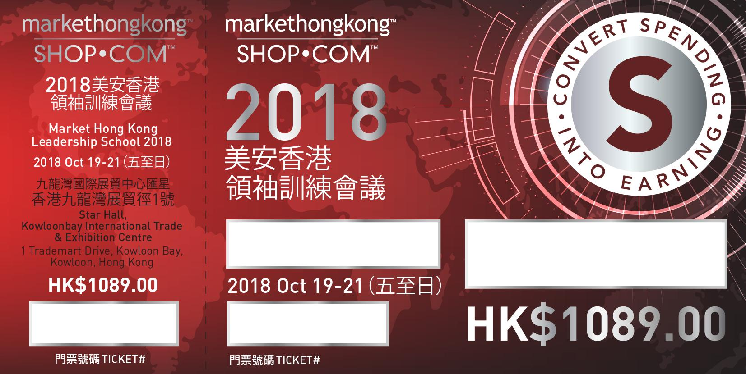
Tickets

Slide 15
Selling tickets is the best team culture

Slide 16
Attend every meetings
Convention is the only shortcut for Success!

Slide 17

SUCCESS is LOVE what you do!

Slide 18

Because we’ve got Market America DNA!!

